Slide 1


Tewodros Hagos
05 June 2025

Slide 2

Outline
Executive Summary
Introduction
Methodology
Results
Conclusion
Appendix

Slide 3
Executive Summary
Summary of Methodologies:
Data Collection
Data Wrangling
Exploratory Data Analysis
Interactive Visual Analytics
Predictive Analysis (Classification)
Summary of Results:
Exploratory Data Analysis (EDA) results
Geospatial analytics
Interactive dashboard
Predictive analysis of classification models

Slide 4
Introduction
Project background:
SpaceX advertises Falcon 9 rocket launches on its website with a cost of 62 million dollars; other providers cost upward of 165 million dollars each, much of the savings is because SpaceX can reuse the first stage.
Problems Statement:
Predict if the first stage will land successfully as well as the cost of a launch in order to bid against SpaceX for a rocket launch.

Slide 5

Section 1

Slide 6
Methodology
Executive Summary
Data collection methodology:
SpaceX API
Web Scrapping from Wikipedia
Perform data wrangling
Data cleaning, e.g., replacing null value with mean or median
One Hot Encoding
Perform exploratory data analysis (EDA) using visualization and SQL
Perform interactive visual analytics using Folium and Plotly Dash
Perform predictive analysis using classification models
Model comparison : Linear Regression, Decision Tress, K-Nearest Neighbors (KNN),

Slide 7
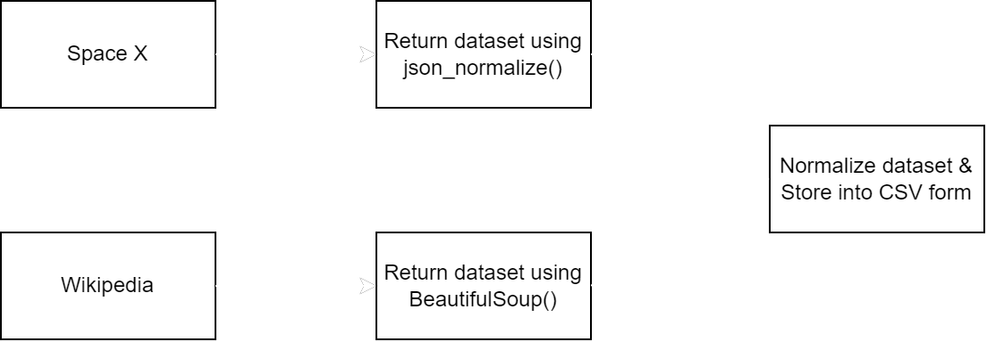
Data Collection
The data sets were collected through below two methods:
SpaceX API
Web Scrapping from Wikipedia
Data collection process:

Slide 8
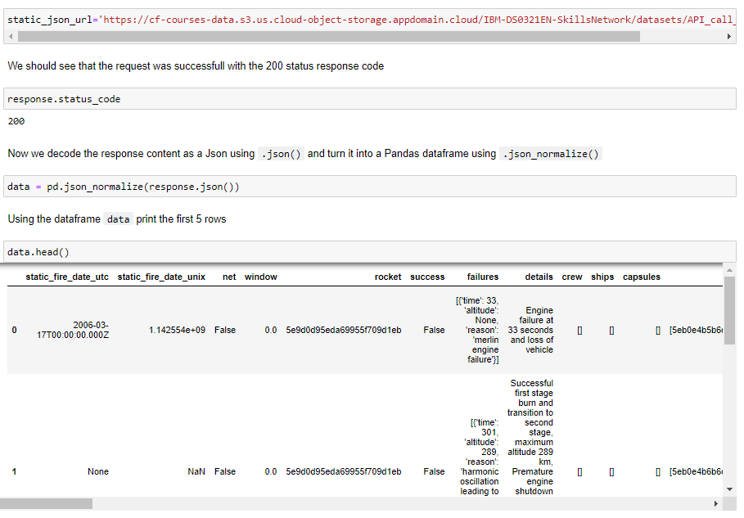
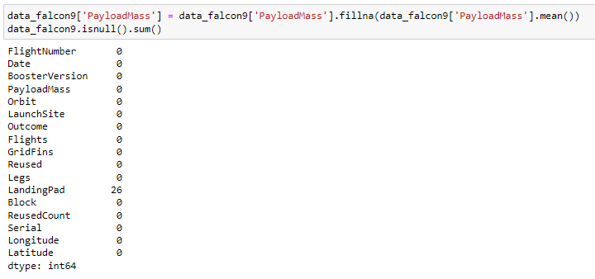
Data Collection – SpaceX API
Request rocket launch data from SpaceX API
Request and parse SpaceX launch data with a GET request and turning the JSON into a Pandas dataframe
Use the functions created for using the API to extract information
Construct dataset from data obtained from API and GET functions into a pandas dictionary with updating columns and rows.
Replace null values with mean and export to CSV file
Place your flowchart of SpaceX API calls here

Slide 9
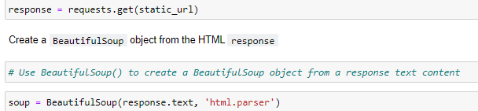
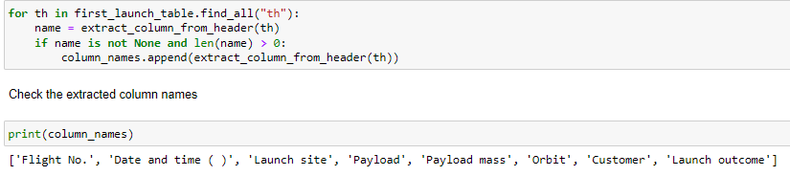
Data Collection - Scraping
Request Falcon9 Launch HTML page HTTP method
Create BeautifulSoup object
Extract column name by iterate through each <th> element from HTML table header.
Fill launch dictionary with launch records extracted from table rows with for loop to append into.
Create dataframe from launch_dict with parsed launch values now added and export to CSV file.
Place your flowchart of web scraping here

Slide 10
Data Wrangling
Load dataset from last section with read_csv function
Calculate the number of column on each site with value_counts saperately.
Use for loop to assign numbers to landing_outcomes, and list the failed landing outcomes
Present list of outcomes with Class assigned as '0' or '1' for failure or success, respectively and export to CSV file.

Slide 11
EDA with Data Visualization
Visualize the relationship between success rate of each orbit type
Visualize the relationship between FlightNumber and Orbit type
Visualize the launch success yearly trend
Create dummy variables to categorical columns

Slide 12
EDA with SQL
The SQL queries performed on the data set were used to:
1. Display the names of the unique launch sites in the space mission
2. Display 5 records where launch sites begin with the string ‘CCA’
3. Display the total payload mass carried by boosters launched by NASA (CRS)
4. Display the average payload mass carried by booster version F9 v1.1
5. List the date when the first successful landing outcome on a ground pad was achieved
6. List the names of the boosters which had success on a drone ship and a payload mass between 4000 and 6000 kg
7. List the total number of successful and failed mission outcomes
8. List the names of the booster versions which have carried the maximum payload mass
9. List the failed landing outcomes on drone ships, their booster versions, and launch site names for 2015
10. Rank the count of landing outcomes (such as Failure (drone ship) or Success (ground pad)) between the date 2010-06-04 and 2017-03-20, in descending order

Slide 13
Build an Interactive Map with Folium
1. Mark all launch sites on a map
Initialise the map using a Folium Map object
Add a folium.Circle and folium.Marker for each launch site on the launch map
2. Mark the success/failed launches for each site on a map
As many launches have the same coordinates, it makes sense to cluster them together.
Before clustering them, assign a marker colour of successful (class = 1) as green, and failed (class = 0) as red.
To put the launches into clusters, for each launch, add a folium.Marker to the MarkerCluster() object.
Create an icon as a text label, assigning the icon_color as the marker_colour determined previously.
3. Calculate the distances between a launch site to its proximities
To explore the proximities of launch sites, calculations of distances between points can be made using the Lat and Long values.
After marking a point using the Lat and Long values, create a folium.Marker object to show the distance.
To display the distance line between two points, draw a folium.PolyLine and add this to the map.

Slide 14
Build a Dashboard with Plotly Dash
1. Pie chart (px.pie()) showing the total successful launches per site
This makes it clear to see which sites are most successful
The chart could also be filtered (using a dcc.Dropdown() object) to see the success/failure ratio for an individual site
2. Scatter graph (px.scatter()) to show the correlation between outcome (success or not) and payload mass (kg)
This could be filtered (using a RangeSlider() object) by ranges of payload masses
It could also be filtered by booster version

Slide 15
Predictive Analysis (Classification)
1. Model Development
Create a GridSearchCV object and a dictionary of parameters
Fit the object to the parameters
Use the training data set to train the model
2. Model Evaluation
Using the output GridSearchCV object
Plot and examine the Confusion Matrix
3. Finding the Best Classification Model
Review the accuracy scores for all chosen algorithms and record the highest one

Slide 16
Results
Exploratory data analysis results
The success rate kept increasing since year 2013.
Orbit at ES-L1, GEO, HEO & SSO with a 100% success rate for rocket launching.
Based on scatter point chart, you will find that the VAFB-SLC launch site has no rockets
launched for heavy payload mass (greater than 10000).
Interactive analytics demo in screenshots
KSC LC-39A had the most successful launches compared with the other sites.
Predictive analysis results
Decision tree is the best model in terms of prediction accuracy in this dataset

Slide 17

Section 2

Slide 18
Flight Number vs. Launch Site
Show a scatter plot of Flight Number vs. Launch Site
Show the screenshot of the scatter plot with explanations

Slide 19
Payload vs. Launch Site
Show a scatter plot of Payload vs. Launch Site
Show the screenshot of the scatter plot with explanations

Slide 20
Success Rate vs. Orbit Type
Show a bar chart for the success rate of each orbit type
Show the screenshot of the scatter plot with explanations

Slide 21
Flight Number vs. Orbit Type
Show a scatter point of Flight number vs. Orbit type
Show the screenshot of the scatter plot with explanations

Slide 22
Payload vs. Orbit Type
Show a scatter point of payload vs. orbit type
Show the screenshot of the scatter plot with explanations

Slide 23
Launch Success Yearly Trend
Show a line chart of yearly average success rate
Show the screenshot of the scatter plot with explanations

Slide 24
All Launch Site Names
Find the names of the unique launch sites
Present your query result with a short explanation here

Slide 25
Launch Site Names Begin with 'CCA'
Find 5 records where launch sites begin with `CCA`
Present your query result with a short explanation here

Slide 26
Total Payload Mass
Calculate the total payload carried by boosters from NASA
Present your query result with a short explanation here

Slide 27
Average Payload Mass by F9 v1.1
Calculate the average payload mass carried by booster version F9 v1.1
Present your query result with a short explanation here

Slide 28
First Successful Ground Landing Date
Find the dates of the first successful landing outcome on ground pad
Present your query result with a short explanation here

Slide 29
Successful Drone Ship Landing with Payload between 4000 and 6000
List the names of boosters which have successfully landed on drone ship and had payload mass greater than 4000 but less than 6000
Present your query result with a short explanation here

Slide 30
Total Number of Successful and Failure Mission Outcomes
Calculate the total number of successful and failure mission outcomes
Present your query result with a short explanation here

Slide 31
Boosters Carried Maximum Payload
List the names of the booster which have carried the maximum payload mass
Present your query result with a short explanation here

Slide 32
2015 Launch Records
List the failed landing_outcomes in drone ship, their booster versions, and launch site names for in year 2015
Present your query result with a short explanation here

Slide 33
Rank Landing Outcomes Between 2010-06-04 and 2017-03-20
Rank the count of landing outcomes (such as Failure (drone ship) or Success (ground pad)) between the date 2010-06-04 and 2017-03-20, in descending order
Present your query result with a short explanation here

Slide 34

Section 3

Slide 35
<Folium Map Screenshot 1>
Replace <Folium map screenshot 1> title with an appropriate title
Explore the generated folium map and make a proper screenshot to include all launch sites’ location markers on a global map
Explain the important elements and findings on the screenshot

Slide 36
<Folium Map Screenshot 2>
Replace <Folium map screenshot 2> title with an appropriate title
Explore the folium map and make a proper screenshot to show the color-labeled launch outcomes on the map
Explain the important elements and findings on the screenshot

Slide 37
<Folium Map Screenshot 3>
Replace <Folium map screenshot 3> title with an appropriate title
Explore the generated folium map and show the screenshot of a selected launch site to its proximities such as railway, highway, coastline, with distance calculated and displayed
Explain the important elements and findings on the screenshot

Slide 38

Section 4

Slide 39
<Dashboard Screenshot 1>
Replace <Dashboard screenshot 1> title with an appropriate title
Show the screenshot of launch success count for all sites, in a piechart
Explain the important elements and findings on the screenshot

Slide 40
<Dashboard Screenshot 2>
Replace <Dashboard screenshot 2> title with an appropriate title
Show the screenshot of the piechart for the launch site with highest launch success ratio
Explain the important elements and findings on the screenshot

Slide 41
<Dashboard Screenshot 3>
Replace <Dashboard screenshot 3> title with an appropriate title
Show screenshots of Payload vs. Launch Outcome scatter plot for all sites, with different payload selected in the range slider
Explain the important elements and findings on the screenshot, such as which payload range or booster version have the largest success rate, etc.

Slide 42

Section 5

Slide 43
Classification Accuracy
Visualize the built model accuracy for all built classification models, in a bar chart
Find which model has the highest classification accuracy

Slide 44
Confusion Matrix
Show the confusion matrix of the best performing model with an explanation

Slide 45
Conclusions
Point 1
Point 2
Point 3
Point 4
…

Slide 46
Appendix
Include any relevant assets like Python code snippets, SQL queries, charts, Notebook outputs, or data sets that you may have created during this project

Slide 47


